Slide 1
Lab Seminar
2024.07.03
16:00(UTC+9)
Seungwan Woo (UST)

Slide 2
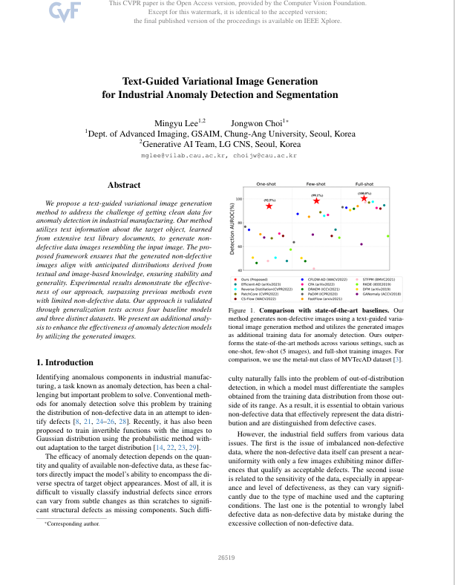
Introduction
Text-Guided Variational Image Generation for Industrial Anomaly Detection and Segmentation
CVPR 2024
Chung-Ang University

Slide 3
Lee, Mingyu, and Jongwon Choi. "Text-Guided Variational Image Generation for Industrial Anomaly Detection and Segmentation." Proceedings of the IEEE/CVF Conference on Computer Vision and Pattern Recognition. 2024.
Introduction
It is difficult to obtain large amounts of data in various industrial fields.
Therefore, it is necessary to enhance the performance of anomaly detection by augmenting limited data.
This paper proposes a method to augment a small amount of non-defective data to create a data pool, which is then used to improve the performance of anomaly detection.

Slide 4
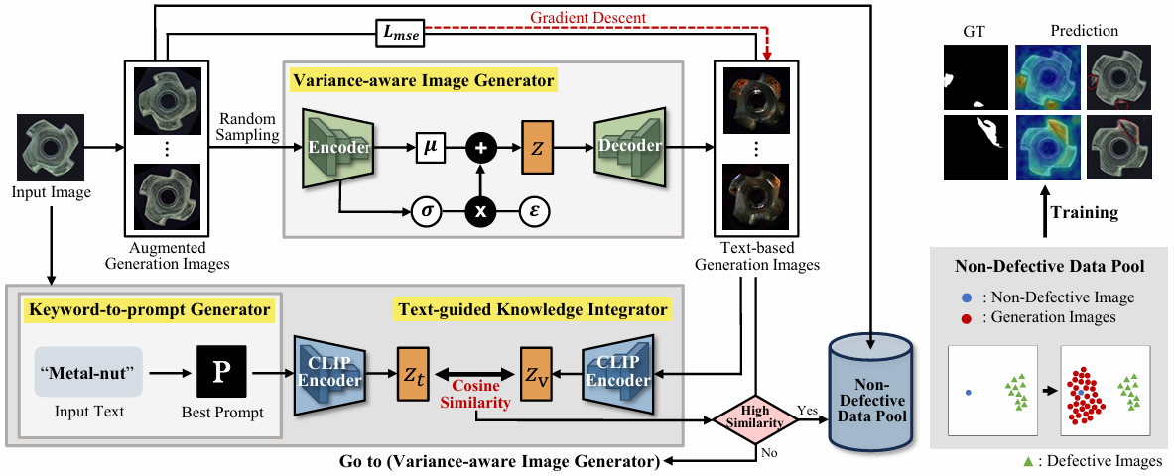
Lee, Mingyu, and Jongwon Choi. "Text-Guided Variational Image Generation for Industrial Anomaly Detection and Segmentation." Proceedings of the IEEE/CVF Conference on Computer Vision and Pattern Recognition. 2024.
Method

Slide 5
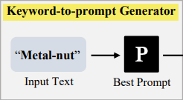
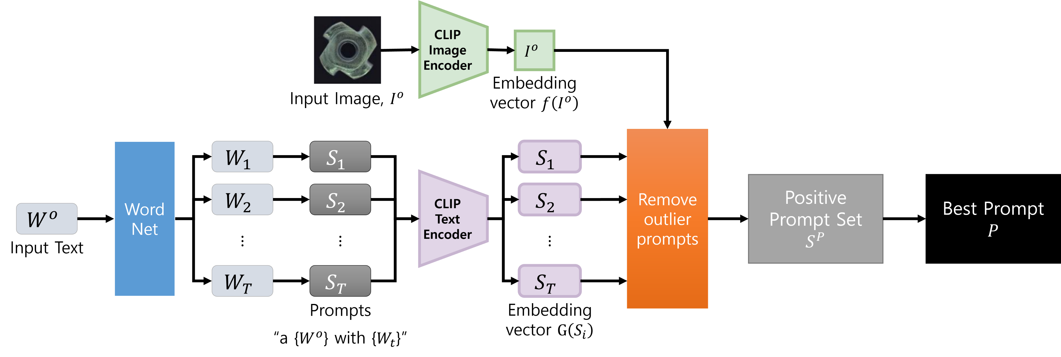
Lee, Mingyu, and Jongwon Choi. "Text-Guided Variational Image Generation for Industrial Anomaly Detection and Segmentation." Proceedings of the IEEE/CVF Conference on Computer Vision and Pattern Recognition. 2024.
Method – Keyword-to-prompt Generator

Slide 6

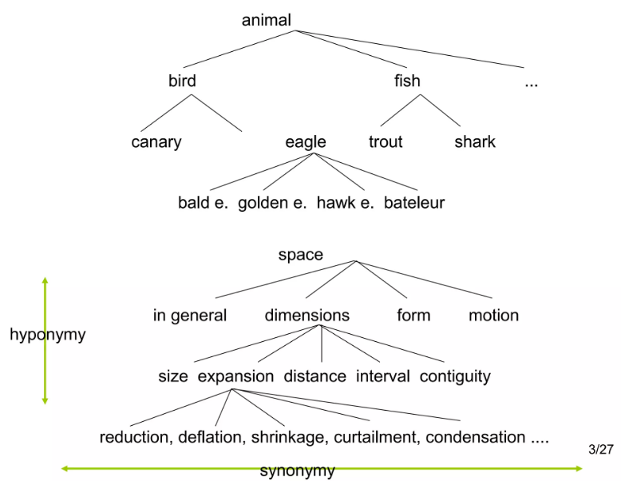
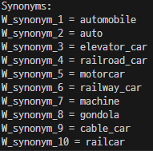
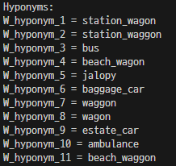
Lee, Mingyu, and Jongwon Choi. "Text-Guided Variational Image Generation for Industrial Anomaly Detection and Segmentation." Proceedings of the IEEE/CVF Conference on Computer Vision and Pattern Recognition. 2024.
Method – Keyword-to-prompt Generator
WordNet
What is WordNet
word = “car”
A Database of Lexical Relations
WORDNET: A Database of Lexical Relations | PPT (slideshare.net)

Slide 7
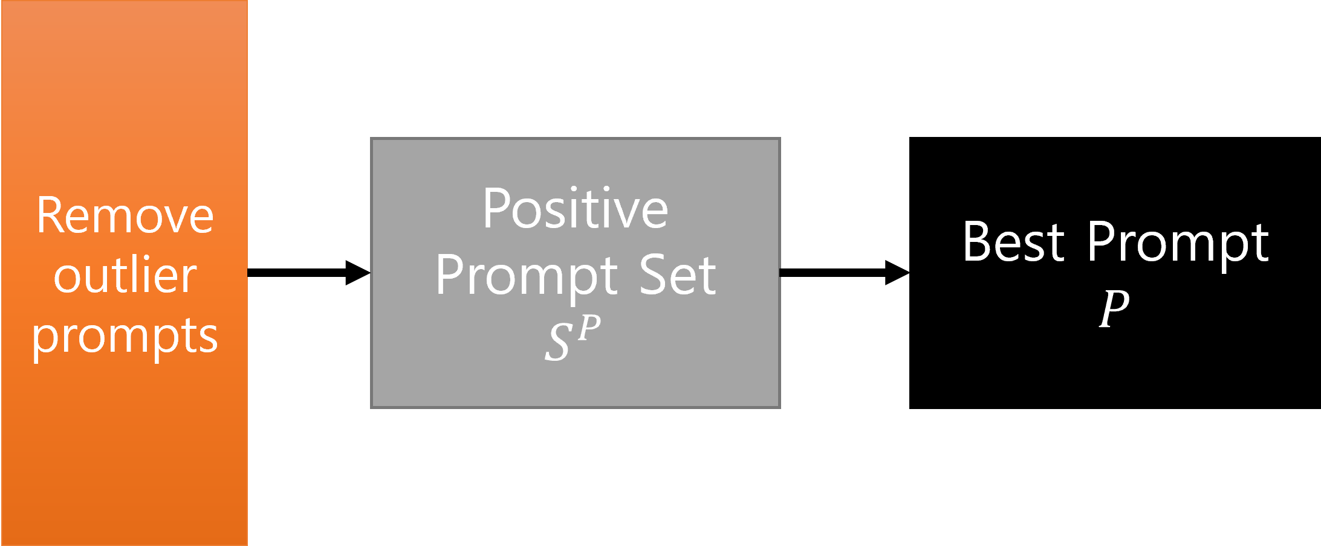
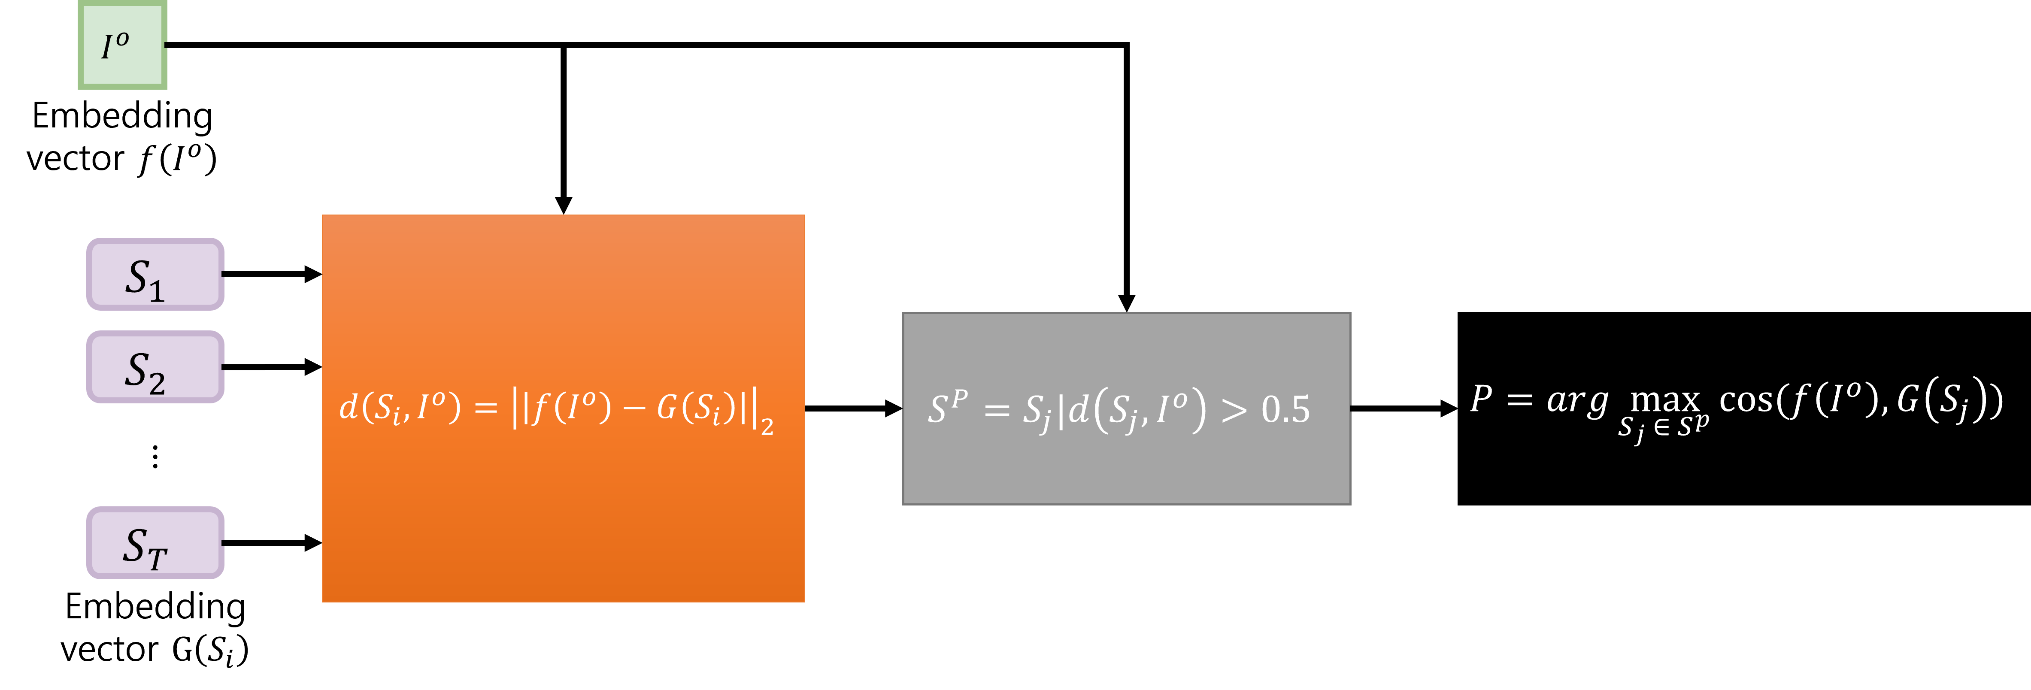


Lee, Mingyu, and Jongwon Choi. "Text-Guided Variational Image Generation for Industrial Anomaly Detection and Segmentation." Proceedings of the IEEE/CVF Conference on Computer Vision and Pattern Recognition. 2024.
Method – Keyword-to-prompt Generator
How to Remove Outlier Prompts, Determine a Positive Prompt set, and Finde the Best Prompt?
Cosine similarity between the two embedding vectors of $f\left(I^{o}\right)$ and $G\left(S_{j}\right)$
$S_{j}|d\left(S_{j},I^{o}\right)≤0.5$= outlier

Slide 8
Lee, Mingyu, and Jongwon Choi. "Text-Guided Variational Image Generation for Industrial Anomaly Detection and Segmentation." Proceedings of the IEEE/CVF Conference on Computer Vision and Pattern Recognition. 2024.
Method – Keyword-to-prompt Generator

Slide 9
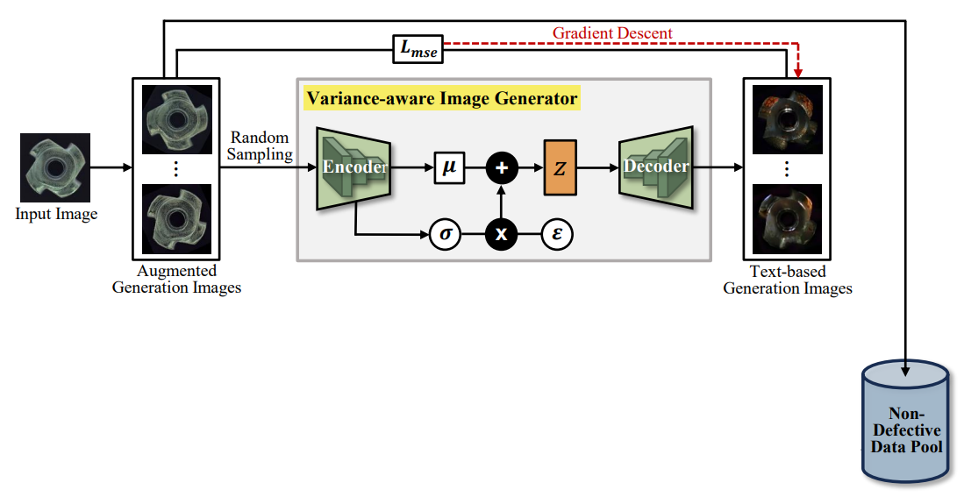
Lee, Mingyu, and Jongwon Choi. "Text-Guided Variational Image Generation for Industrial Anomaly Detection and Segmentation." Proceedings of the IEEE/CVF Conference on Computer Vision and Pattern Recognition. 2024.
Method – Variance-aware Image Generator
Rotation, Scaling, Color Jittering, …

Slide 10
Lee, Mingyu, and Jongwon Choi. "Text-Guided Variational Image Generation for Industrial Anomaly Detection and Segmentation." Proceedings of the IEEE/CVF Conference on Computer Vision and Pattern Recognition. 2024.
Method – Variance-aware Image Generator
Rotation, Scaling, Color Jittering, …
VQGAN

Slide 11
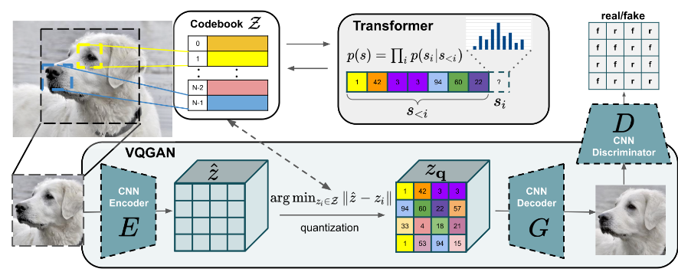
Lee, Mingyu, and Jongwon Choi. "Text-Guided Variational Image Generation for Industrial Anomaly Detection and Segmentation." Proceedings of the IEEE/CVF Conference on Computer Vision and Pattern Recognition. 2024.
Method – Variance-aware Image Generator

Slide 12
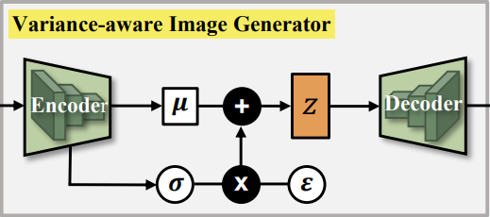
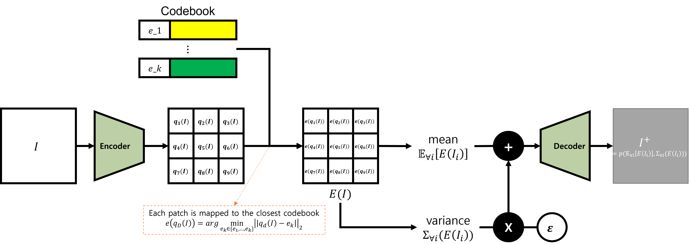

Lee, Mingyu, and Jongwon Choi. "Text-Guided Variational Image Generation for Industrial Anomaly Detection and Segmentation." Proceedings of the IEEE/CVF Conference on Computer Vision and Pattern Recognition. 2024.
Method – Variance-aware Image Generator
$I_{i}$: $i$-th augmented one

Slide 13


Lee, Mingyu, and Jongwon Choi. "Text-Guided Variational Image Generation for Industrial Anomaly Detection and Segmentation." Proceedings of the IEEE/CVF Conference on Computer Vision and Pattern Recognition. 2024.
Method – Variance-aware Image Generator
Rotation, Scaling, Color Jittering, …
$$I_{1}, I_{2}, …,I_{N}$$
$$I_{1}^{+}, I_{2}^{+}, …,I_{M}^{+}$$

Slide 14
Lee, Mingyu, and Jongwon Choi. "Text-Guided Variational Image Generation for Industrial Anomaly Detection and Segmentation." Proceedings of the IEEE/CVF Conference on Computer Vision and Pattern Recognition. 2024.
Method – Text-guided Knowledge Integrator

Slide 15
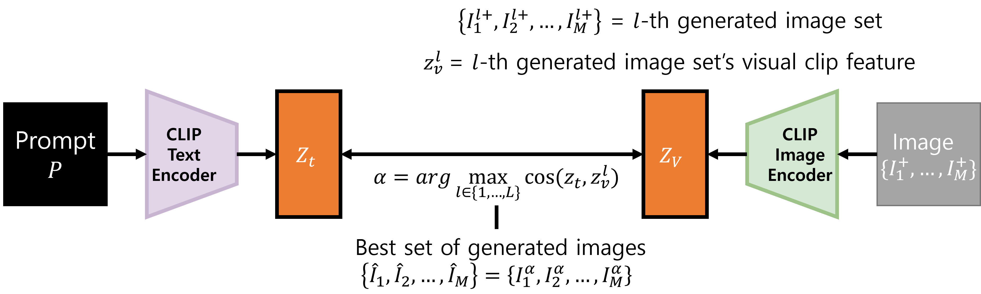
Lee, Mingyu, and Jongwon Choi. "Text-Guided Variational Image Generation for Industrial Anomaly Detection and Segmentation." Proceedings of the IEEE/CVF Conference on Computer Vision and Pattern Recognition. 2024.
Method – Text-guided Knowledge Integrator

Slide 16
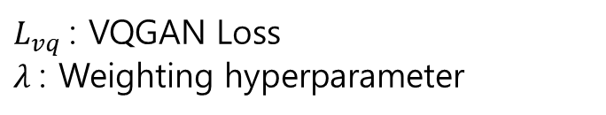

Lee, Mingyu, and Jongwon Choi. "Text-Guided Variational Image Generation for Industrial Anomaly Detection and Segmentation." Proceedings of the IEEE/CVF Conference on Computer Vision and Pattern Recognition. 2024.
Method – Text-guided Knowledge Integrator
$$L_{mse}\left(I^{o},\left\{I_{1}^{+},…,I_{M}^{+}\right\}\right)=\frac{1}{n}\sum_{m=1}^{M}{{\left|\left|I^{o}−I_{m}^{+}\right|\right|}_{2}^{2}}$$
$L_{vq}$: VQGAN Loss
$λ$: Weighting hyperparameter
$${L=L}_{mse}\left(I^{o},\left\{I_{1}^{+},…,I_{M}^{+}\right\}\right)+λL_{vq}\left(\left\{I_{1},…,I_{N}\right\}\right)$$

Slide 17
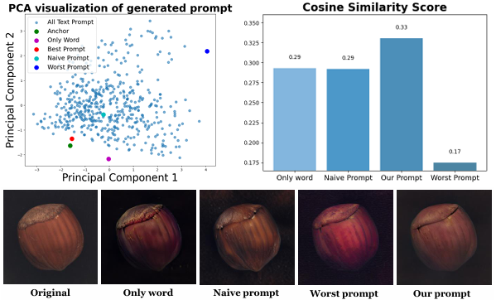
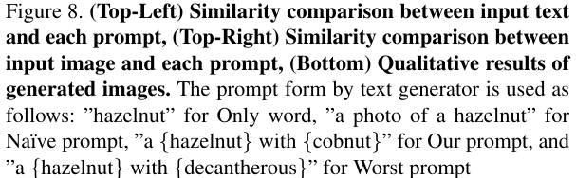
Lee, Mingyu, and Jongwon Choi. "Text-Guided Variational Image Generation for Industrial Anomaly Detection and Segmentation." Proceedings of the IEEE/CVF Conference on Computer Vision and Pattern Recognition. 2024.
Experience

Slide 18
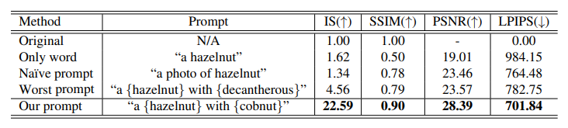
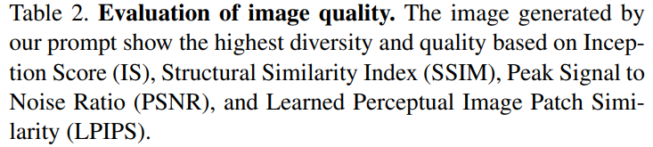
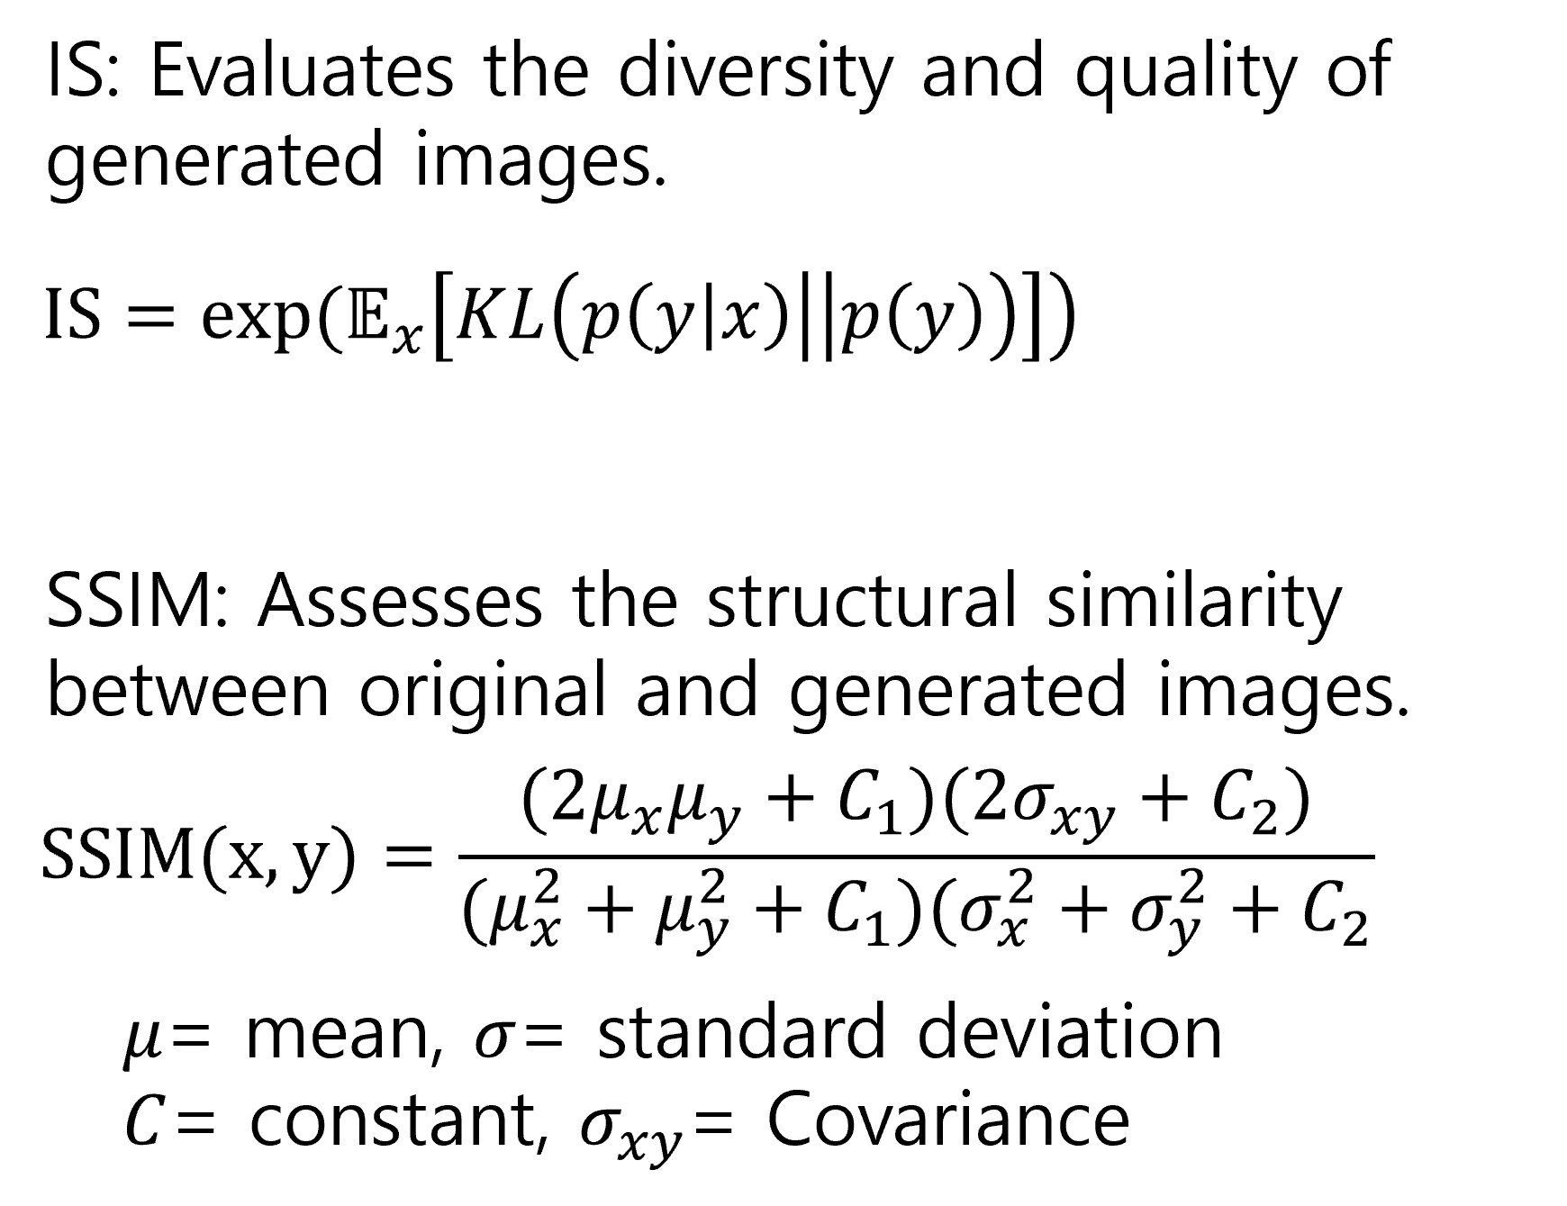
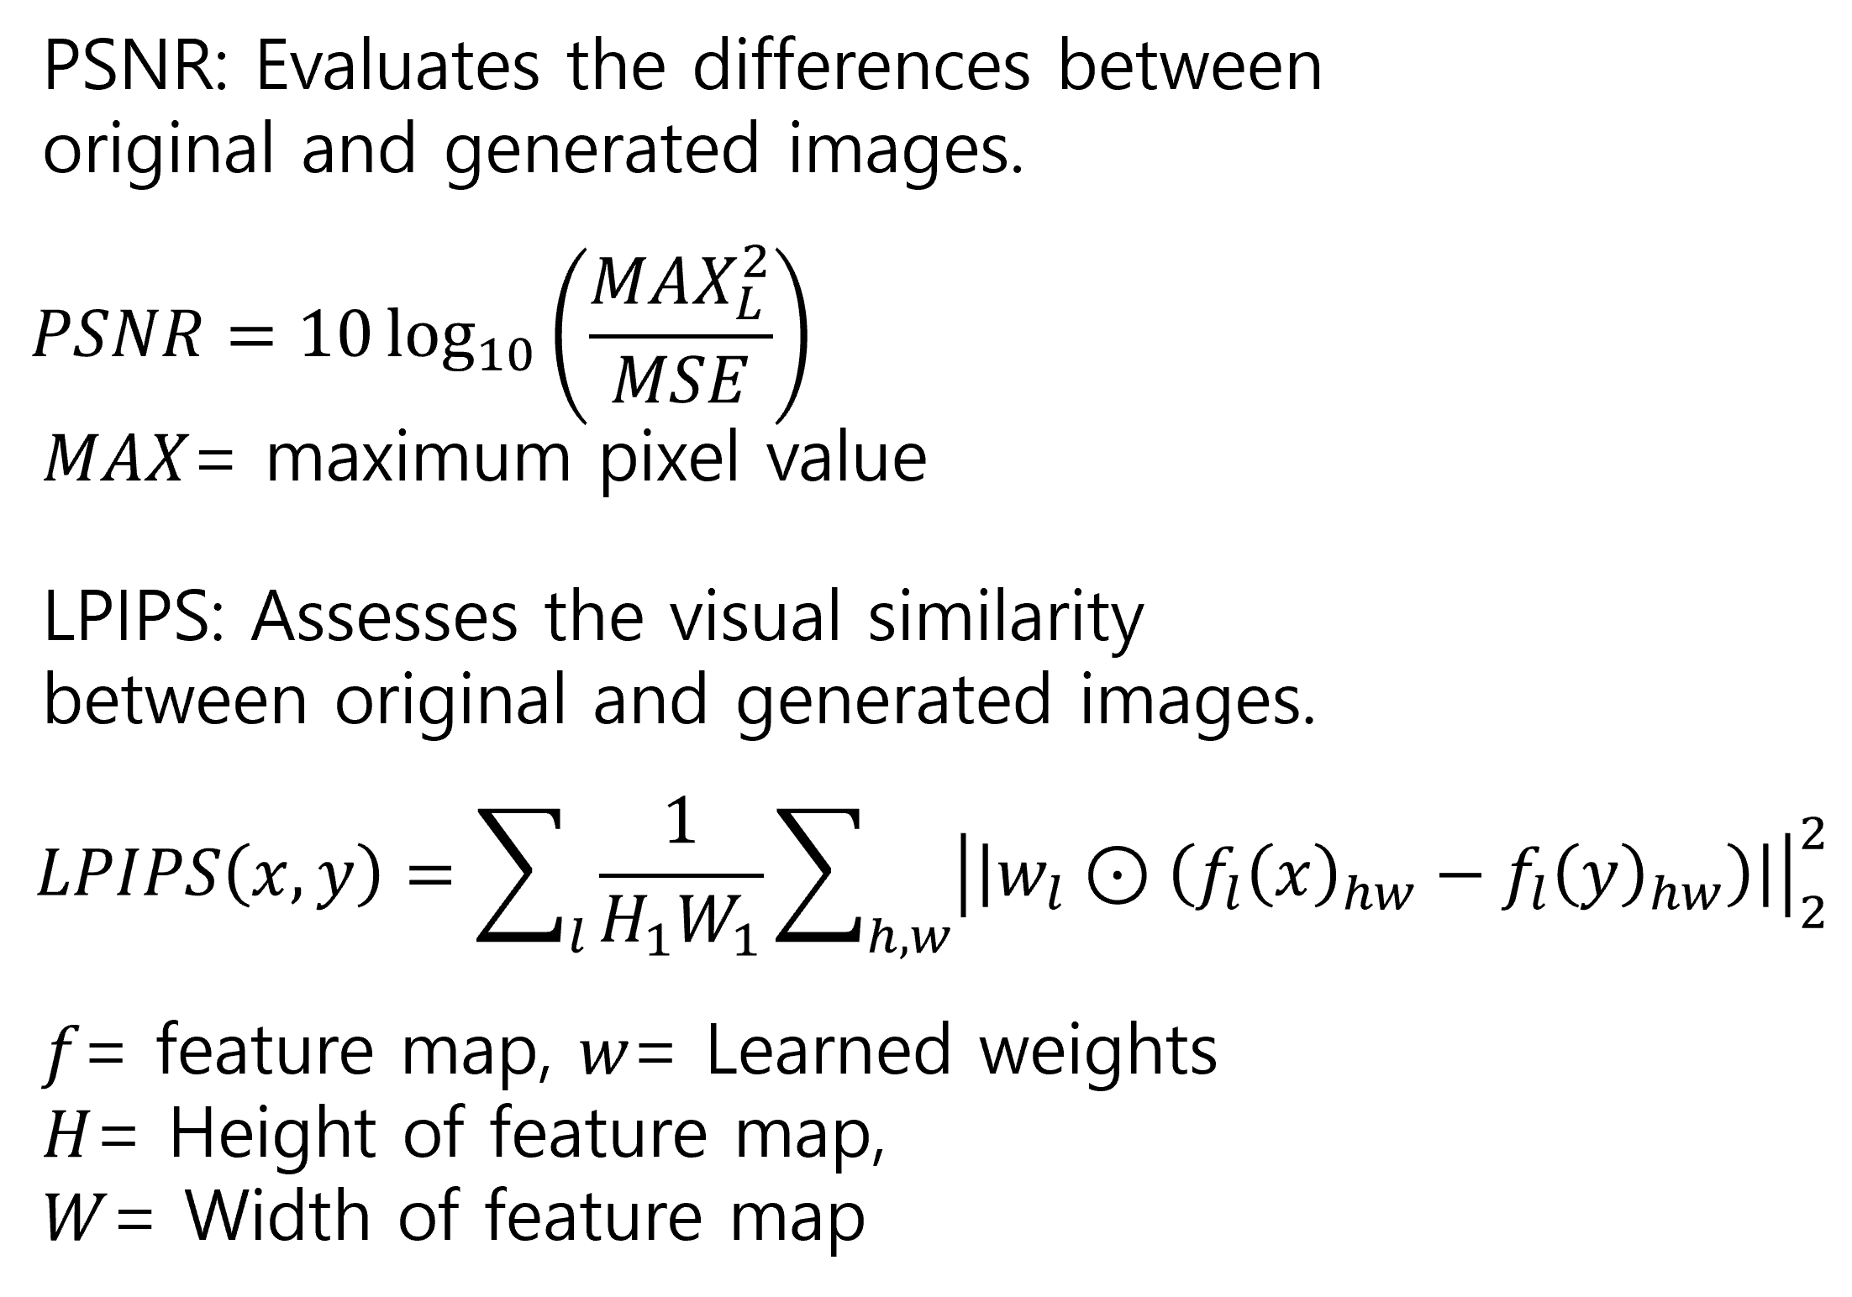
Lee, Mingyu, and Jongwon Choi. "Text-Guided Variational Image Generation for Industrial Anomaly Detection and Segmentation." Proceedings of the IEEE/CVF Conference on Computer Vision and Pattern Recognition. 2024.
Experience

Slide 19
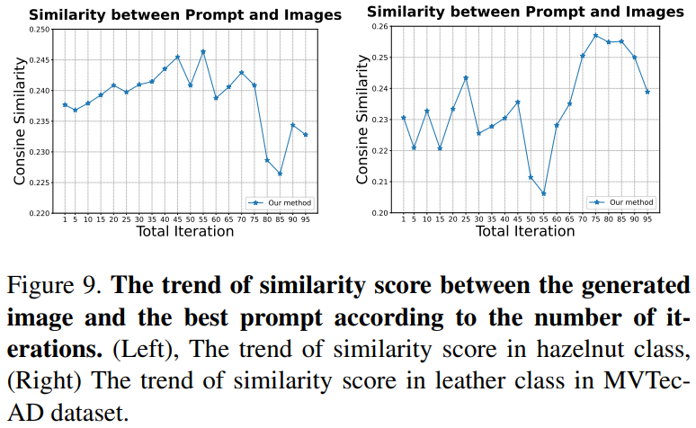
Lee, Mingyu, and Jongwon Choi. "Text-Guided Variational Image Generation for Industrial Anomaly Detection and Segmentation." Proceedings of the IEEE/CVF Conference on Computer Vision and Pattern Recognition. 2024.
Experience

Slide 20
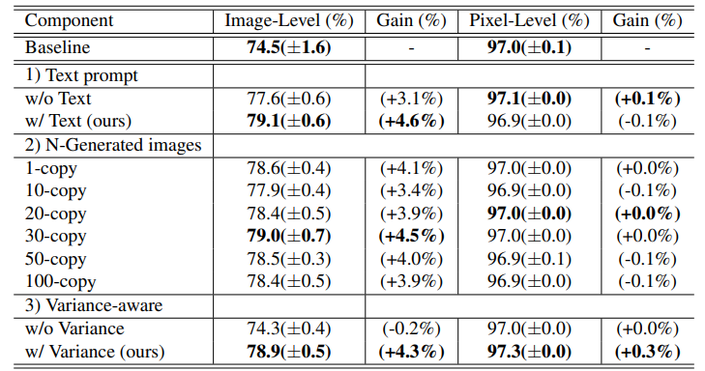
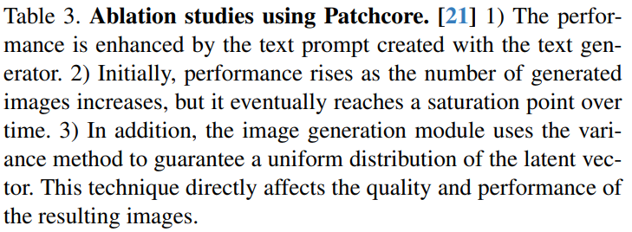
Lee, Mingyu, and Jongwon Choi. "Text-Guided Variational Image Generation for Industrial Anomaly Detection and Segmentation." Proceedings of the IEEE/CVF Conference on Computer Vision and Pattern Recognition. 2024.
Experience

Slide 21
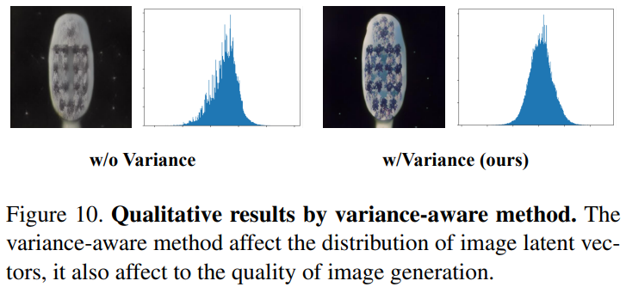
Lee, Mingyu, and Jongwon Choi. "Text-Guided Variational Image Generation for Industrial Anomaly Detection and Segmentation." Proceedings of the IEEE/CVF Conference on Computer Vision and Pattern Recognition. 2024.
Experience

Slide 22
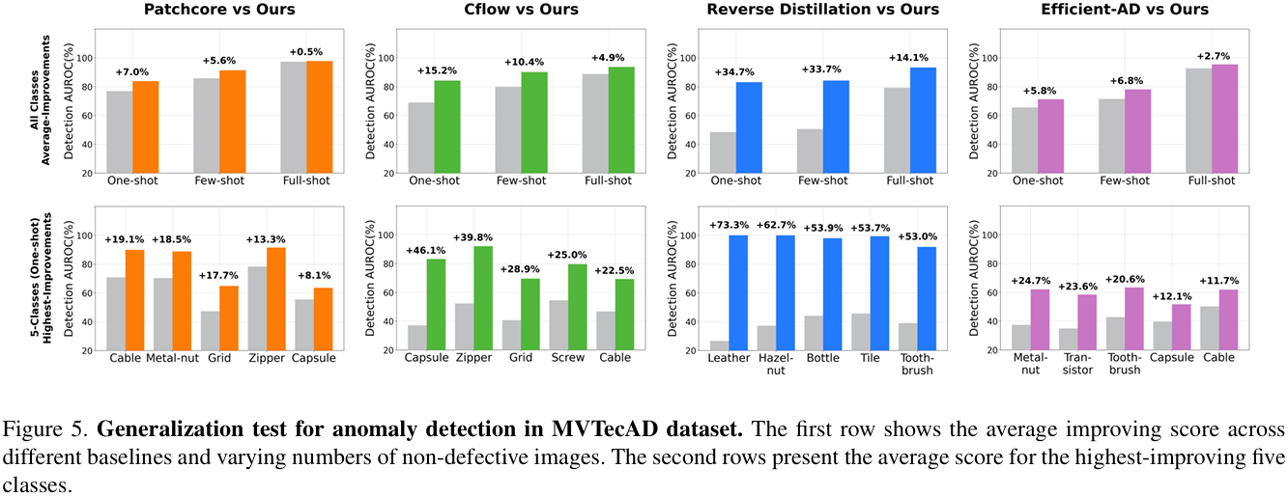
Lee, Mingyu, and Jongwon Choi. "Text-Guided Variational Image Generation for Industrial Anomaly Detection and Segmentation." Proceedings of the IEEE/CVF Conference on Computer Vision and Pattern Recognition. 2024.
Experience

Slide 23
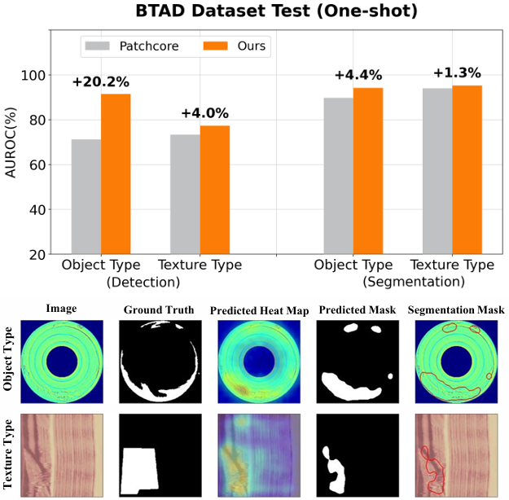
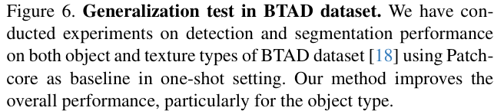
Lee, Mingyu, and Jongwon Choi. "Text-Guided Variational Image Generation for Industrial Anomaly Detection and Segmentation." Proceedings of the IEEE/CVF Conference on Computer Vision and Pattern Recognition. 2024.
Experience

Slide 24
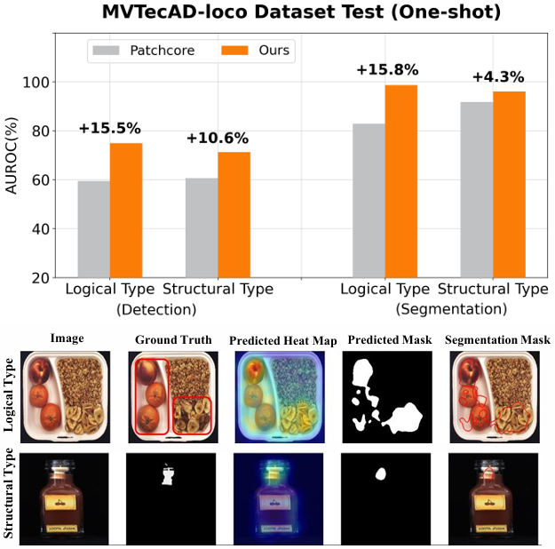
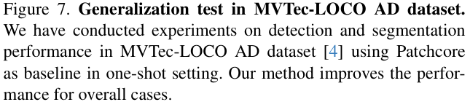
Lee, Mingyu, and Jongwon Choi. "Text-Guided Variational Image Generation for Industrial Anomaly Detection and Segmentation." Proceedings of the IEEE/CVF Conference on Computer Vision and Pattern Recognition. 2024.
Experience

Slide 25
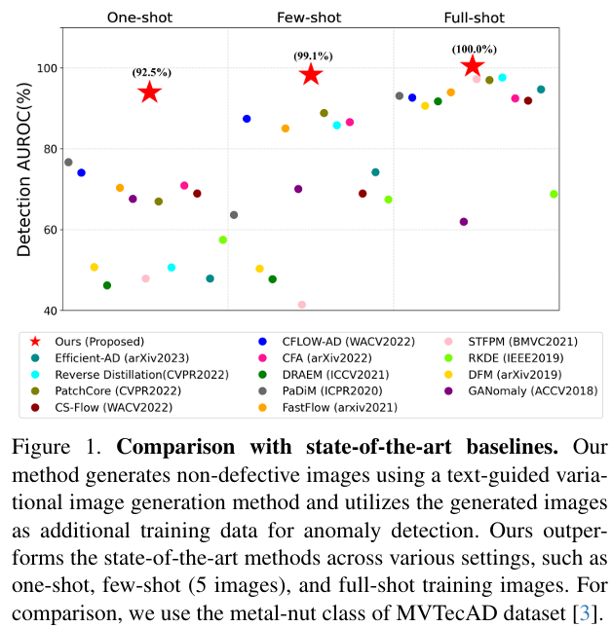
Lee, Mingyu, and Jongwon Choi. "Text-Guided Variational Image Generation for Industrial Anomaly Detection and Segmentation." Proceedings of the IEEE/CVF Conference on Computer Vision and Pattern Recognition. 2024.
Experience

Slide 26
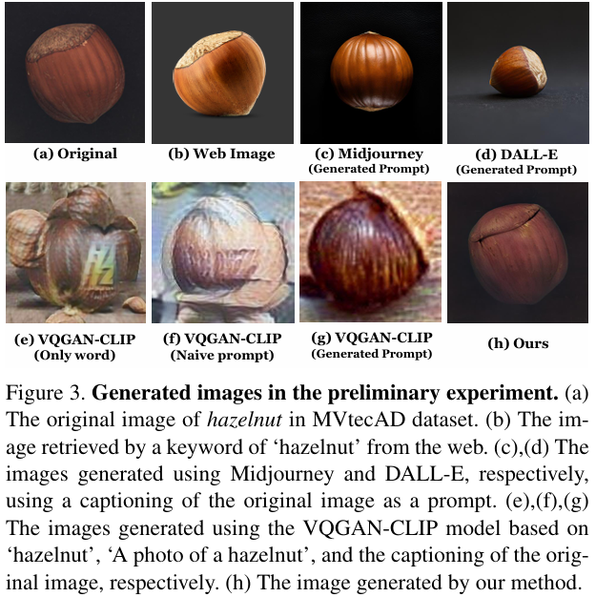
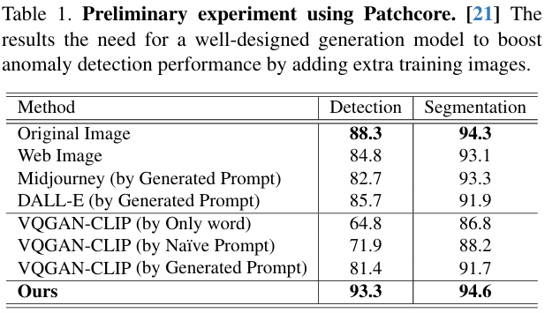
Lee, Mingyu, and Jongwon Choi. "Text-Guided Variational Image Generation for Industrial Anomaly Detection and Segmentation." Proceedings of the IEEE/CVF Conference on Computer Vision and Pattern Recognition. 2024.
Experience

Slide 27
Lee, Mingyu, and Jongwon Choi. "Text-Guided Variational Image Generation for Industrial Anomaly Detection and Segmentation." Proceedings of the IEEE/CVF Conference on Computer Vision and Pattern Recognition. 2024.
Conclusion
Why I reviewed this paper?
I think …
In various industries, it is essential to work with limited data for anomaly detection.
And, generating highly consistent images is necessary.
Also, This is closely related to future tasks that need to be addressed.

Slide 28
Thank you!

